Slide 1
ADVANCED NETWORKING
INSTRUCTOR : FRED KAGAME
School Computing and IT
BIT,MSIT,CCNA,CCNP,CISA

Slide 2

CHAPTER TWO : Internet Protocol

Slide 3
Internet Protocol (IP)
The Internet Protocol (IP) is a network layer protocol (Layer 3 in the OSI model) that is responsible for:
Identifying devices on a network using IP addresses.
Delivering data packets from a source device to a destination device across interconnected networks (the internet).
Providing logical addressing (IP addresses) as opposed to physical addressing (MAC addresses).

Slide 4
Characteristics of IP
Connectionless: IP does not establish a dedicated connection before transmitting data. Each packet is sent independently.
Best-Effort Delivery: IP does not guarantee the successful delivery of packets; packets may be lost, duplicated, or delivered out of order.
Packet-Switched: Data is broken down into smaller units called packets that are sent separately and reassembled at the destination.
Protocol Interaction:
Networks require the use of several protocols.
Each protocol has its own function and format.

Slide 5
Role of IP in Modern Networking
IP plays a vital role in almost every network in operation today, from small home networks to vast global infrastructures like the Internet. The responsibilities of IP include:
Addressing: Each device on a network is assigned a unique IP address, which serves as its identifier. This ensures data can be routed to the correct destination.
Routing: IP facilitates the process of determining the best path for data to travel across multiple interconnected networks, using routers as intermediary devices.
Packet Handling: IP manages the fragmentation and reassembly of data packets when necessary, ensuring data is transmitted efficiently, even across networks with different transmission capacities.
In modern networks, IP:
Supports the Internet, allowing billions of devices to communicate.
Underpins services like web browsing, email, streaming, cloud computing, and IoT (Internet of Things). Works alongside higher-level protocols such as TCP (Transmission Control Protocol) and UDP (User Datagram Protocol) to provide reliable and efficient communication.

Slide 6
Define the OSI layers, understand the function of each, and describe how devices
and networking protocols can be mapped to each layer. You must remember the seven
layers of the OSI model and what function each layer provides. The Application, Presentation,
and Session layers are upper layers and are responsible for communicating from a user interface
to an application. The Transport layer provides segmentation, sequencing, and virtual circuits.
The Network layer provides logical network addressing and routing through an internetwork.
The Data Link layer provides framing and placing of data on the network medium. The Physical
layer is responsible for taking 1s and 0s and encoding them into a digital signal for transmission
on the network segment.
Differentiate a MAC address and an IP address and describe how and when each
address type is used in a network. A MAC address is a hexadecimal number identifying the
physical connection of a host. MAC addresses are said to operate on layer 2 of the OSI model. IP
addresses, which can be expressed in binary or decimal format, are logical identifiers that are
said to be on layer 3 of the OSI model. Hosts on the same physical segment locate one another
with MAC addresses, while IP addresses are used when they reside on different LAN segments or
subnets.

Slide 7
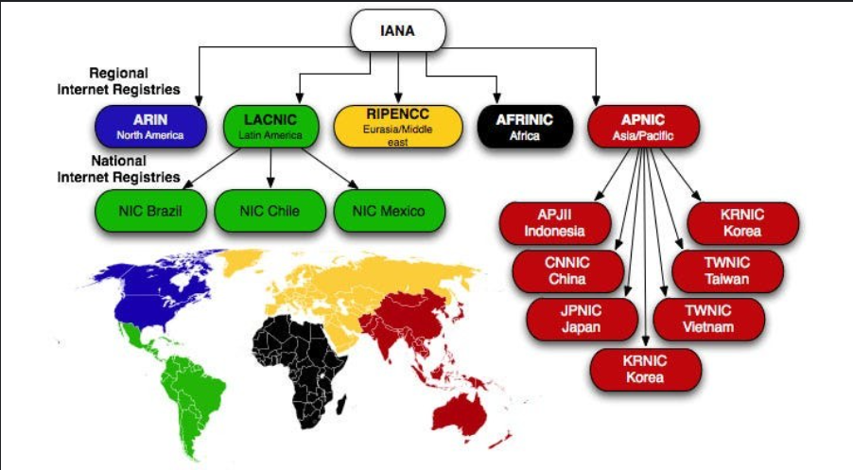
AFRINIC and IANA
The IANA is a set of services run by ICANN. It is responsible for the global coordination of domain names, Internet number resources (IPv4, IPv6 and ASN) and protocol assignments. One of its roles is to allocate IP addresses from the pools of unallocated addresses to five RIRs. AFRINIC and the other RIRs have been delegated the task of distributing and registering Internet number resources to their members in their defined service regions. The RIRs also register reverse DNS delegations
AFRINIC, as an RIR, manages the distribution of these IP resources within Africa, ensuring the region’s growing internet needs are met.
IANA acts at a global level, distributing large blocks of IP addresses and ASNs to the RIRs, including AFRINIC.

Slide 8
Evolution of IP: From IPv4 to IPv6
The initial version of the Internet Protocol, IPv4, has been the backbone of the Internet for decades. However, with the exponential growth of connected devices, IPv4's limitations, particularly its address space, became evident.
IPv4 (Internet Protocol Version 4)
IPv4 Addressing is a fundamental aspect of network design and configuration. IPv4 addresses are 32-bit numbers typically written in decimal format as four octets separated by periods (e.g., 192.168.1.1).
IPv4 Address Structure - Network and Host Portions
An IPv4 address is a 32-bit hierarchical address that is made up of a network portion and a host portion.
When subnet mask is used to determine the network and host portions.

Slide 9
An IPv4 address is 32 bits long, and each bit can be either 0 or 1.
The total number of possible IPv4 addresses is calculated as:2^32=4,294,967,296
However, not all of these IP addresses are usable for general purposes.
Several ranges of addresses are reserved for special uses, including:
Private IP addresses (reserved for internal networks):
10.0.0.0/8 (16,777,216 addresses)
172.16.0.0/12 (1,048,576 addresses)
192.168.0.0/16 (65,536 addresses)
Loopback addresses: 127.0.0.0/8 (16,777,216 addresses)
Multicast addresses: 224.0.0.0/4 (268,435,456 addresses)
Link-local addresses (used for local network traffic): 169.254.0.0/16 (65,536 addresses)
Broadcast addresses (used for network-wide broadcasts).Reserved addresses for special use, testing, and documentation.

Slide 10
IPv4 Addressing is a fundamental aspect of network design and configuration. IPv4 addresses are 32-bit numbers typically written in decimal format as four octets separated by periods (e.g., 192.168.1.1).
Types of IPv4 Addresses
Legacy Classful Addressing
RFC 790 (1981) allocated IPv4 addresses in classes
Class A (0.0.0.0/8 to 127.0.0.0/8)
Class B (128.0.0.0 /16 – 191.255.0.0 /16)
Class C (192.0.0.0 /24 – 223.255.255.0 /24)
Class D (224.0.0.0 to 239.0.0.0)
Class E (240.0.0.0 – 255.0.0.0)

Slide 11
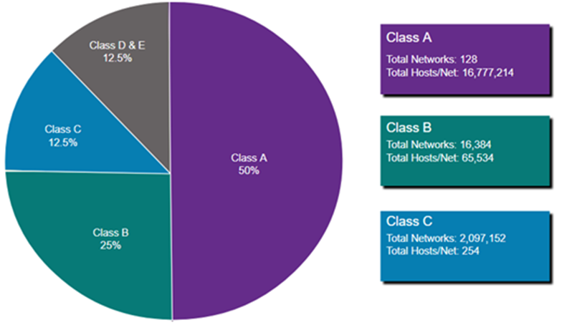
Classful address allocation was replaced with classless addressing which ignores the rules of classes (A, B, C).

Slide 12
Public and Private IP addresses
Public and Private IP addresses are two types of IP address ranges defined by the Internet Assigned Numbers Authority (IANA). These IP addresses are used to identify devices on a network, and their key difference lies in their scope and usage.
1. Public IP Addresses:
Public IP addresses are globally unique and are used to identify devices on the internet. These addresses are assigned by Internet Service Providers (ISPs) to routers, web servers, and other devices that need to be accessed from the broader internet.
Public IPs are routable on the internet, which means they are used for communication across the internet.
Assigned by IANA or regional authorities (like ARIN, RIPE, etc.) to ISPs, companies, and other organizations that need them.
Examples of Public IP ranges:
8.8.8.8 (Google DNS)
172.217.12.174 (Google's website)
Any device with a public IP can be accessed directly over the internet, assuming proper routing and security are in place.)

Slide 13
Private IP Addresses
Private IP addresses are used within local networks (LANs) and are not routable on the public internet. They are intended for communication within a private network, such as a home, office, or data center.
Devices like computers, smartphones, printers, and servers within a private network are assigned private IPs. Routers with Network Address Translation (NAT) convert private IPs to a public IP when a device on the private network needs to communicate over the internet.
These IP ranges are reserved and can be used freely by anyone for internal network purposes, without needing to request them from any authority. However, they cannot be used on the internet.
Private IP ranges (as defined by RFC 1918):
10.0.0.0 – 10.255.255.255 (10.0.0.0/8)
172.16.0.0 – 172.31.255.255 (172.16.0.0/12)
192.168.0.0 – 192.168.255.255 (192.168.0.0/16

Slide 14
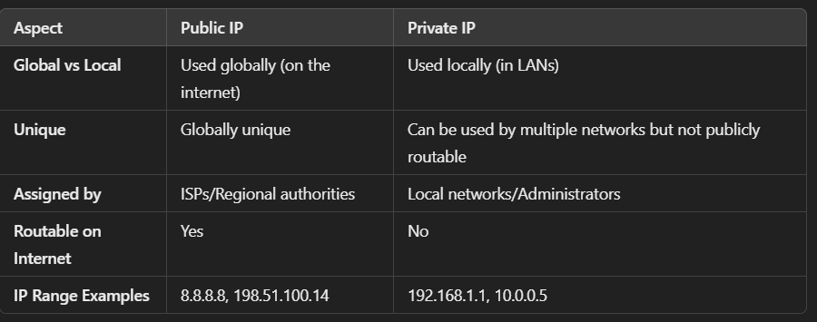
Key Differences:

Slide 15
An IPv4 address is a 32-bit hierarchical address that is made up of a network portion and a host portion.
When determining the network portion versus the host portion, you must look at the 32-bit stream.

Slide 17
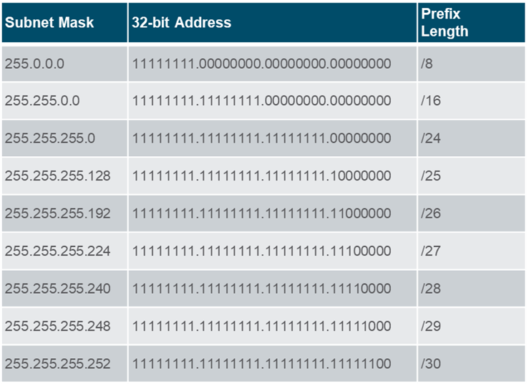
The Prefix Length
A prefix length is a less cumbersome method used to identify a subnet mask address
The prefix length is the number of bits set to 1 in the subnet mask.
It is written in “slash notation” therefore, count the number of bits in the subnet mask and prepend it with a slash.

Slide 18
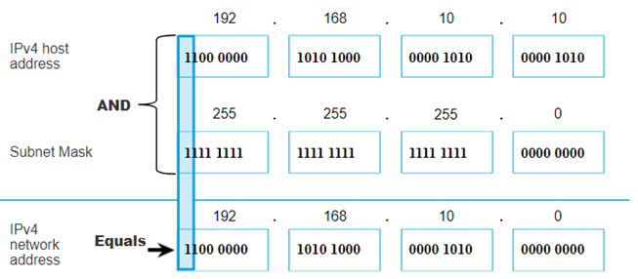
Determining the Network: Logical AND
A logical AND Boolean operation is used in determining the network address.
Logical AND is the comparison of two bits where only a 1 AND 1 produces a 1 and any other combination results in a 0.
1 AND 1 = 1, 0 AND 1 = 0, 1 AND 0 = 0, 0 AND 0 = 0
1 = True and 0 = False
To identify the network address, the host IPv4 address is logically ANDed, bit by bit, with the subnet mask to identify the network address.

Slide 19
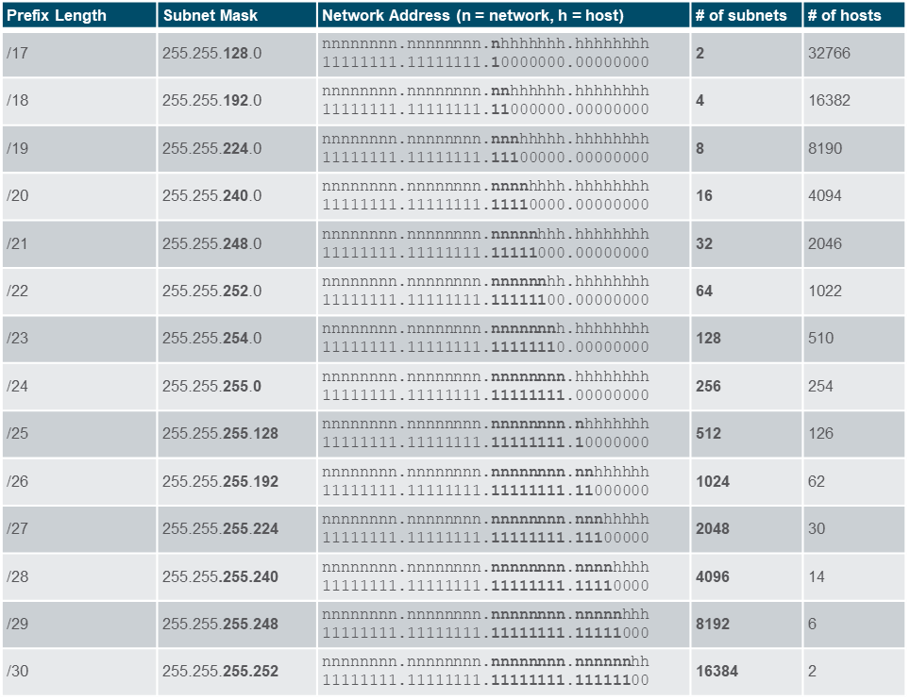
Subnets with a Slash 16 prefix
• The table highlights all the possible scenarios for subnetting a /16 prefix.

Slide 20
subnetting
1. Original Network Information
IP Address: 172.16.0.0
Class: B
Default Subnet Mask (Class B): /16 or 255.255.0.0
Total IP Addresses (in /16): 2¹⁶ = 65,536
Usable Hosts: 65,536 - 2 = 65,534
🔹 2. Subnetting Requirement
Goal: Create 4 subnets from 172.16.0.0/16

Slide 21
Subnetting a Class B Network: 172.16.0.0/16 into 4 Subnets
1. Original Network Information
IP Address: 172.16.0.0
Class: B
Default Subnet Mask (Class B): /16 or 255.255.0.0
Total IP Addresses (in /16): 2¹⁶ = 65,536
Usable Hosts: 65,536 - 2 = 65,534
2. Subnetting Requirement
Goal: Create 4 subnets from 172.16.0.0/16
Number of Subnets=2^{n} n = Number of bits borrowed from the host portion.
Used when creating more subnets. Number of Hosts per Subnet
Hosts per Subnet=2^{h}−2 h = Number of bits left for hosts (after subnetting). Subtract 2 for network address and broadcast address.

Slide 22
New Subnet Mask (CIDR Notation)
New Prefix=Default Prefix+𝑛 for Class B, default prefix = 16 If you borrow 2 bits: /16 + 2 = /18
New Subnet Mask: 255.255.192.0
Block Size (Subnet Increment)
Block Size=256−Subnet Mask Octet when subnetting within a specific octet. Example: Subnet mask is 255.255.192.0, Third octet: 192 Block Size=256−192=64 Block Size=256−192=64 Subnets will increase by 64 in the third octet.

Slide 23
5. Resulting Subnets
🔹 4. New Subnet Details
Each /18 subnet:
Number of IPs:
214=16,3842^{14} = 16,384214=16,384
Usable hosts per subnet:
16,384−2=16,38216,384 - 2 = 16,38 216,384−2=16,382
Block Size: 2⁸ × 2 = 64 × 256 = 16,384 addresses
Increment per subnet: 64 in the third octet (since you're borrowing 2 bits into the third octet)
Subnet No. | Network Address | First Host | Last Host | Broadcast Address
1 | 172.16.0.0/18 | 172.16.0.1 | 172.16.63.254 | 172.16.63.255
2 | 172.16.64.0/18 | 172.16.64.1 | 172.16.127.254 | 172.16.127.255
3 | 172.16.128.0/18 | 172.16.128.1 | 172.16.191.254 | 172.16.191.255
4 | 172.16.192.0/18 | 172.16.192.1 | 172.16.255.254 | 172.16.255.255

Slide 24
6. Summary
Original Network: 172.16.0.0/16
New Subnet Mask: /18 (255.255.192.0)
Number of Subnets: 4
Usable Hosts per Subnet: 16,382
Addresses per Subnet: 16,384
Address Range per Subnet: Spans 64 values in the 3rd octet

Slide 25
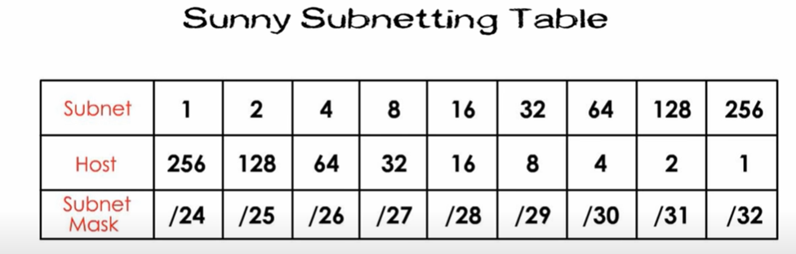
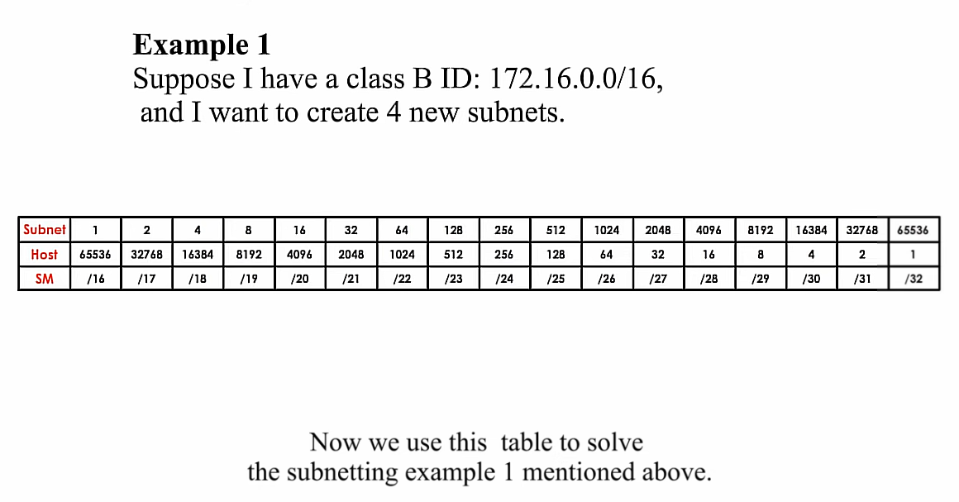

Slide 26
VLSM (Variable Length Subnet Masking)
VLSM is a technique that allows network administrators to divide an IP address space into subnets of different sizes. It is an enhancement of traditional fixed-length subnetting and is particularly useful for conserving IPv4 addresses, especially in scenarios where subnets of various sizes are needed.
Key Concepts of VLSM:
Efficient Use of IP Address Space:
VLSM allows for the creation of subnets with different subnet masks based on the specific number of required hosts. This conserves IPv4 addresses by minimizing waste, as subnets can be tailored to fit the exact number of devices needed in each network segment.
Hierarchical Addressing:
By using VLSM, networks can be divided into smaller subnets and then further subnetted as needed. This creates a more organized and hierarchical network, improving routing efficiency.

Slide 27
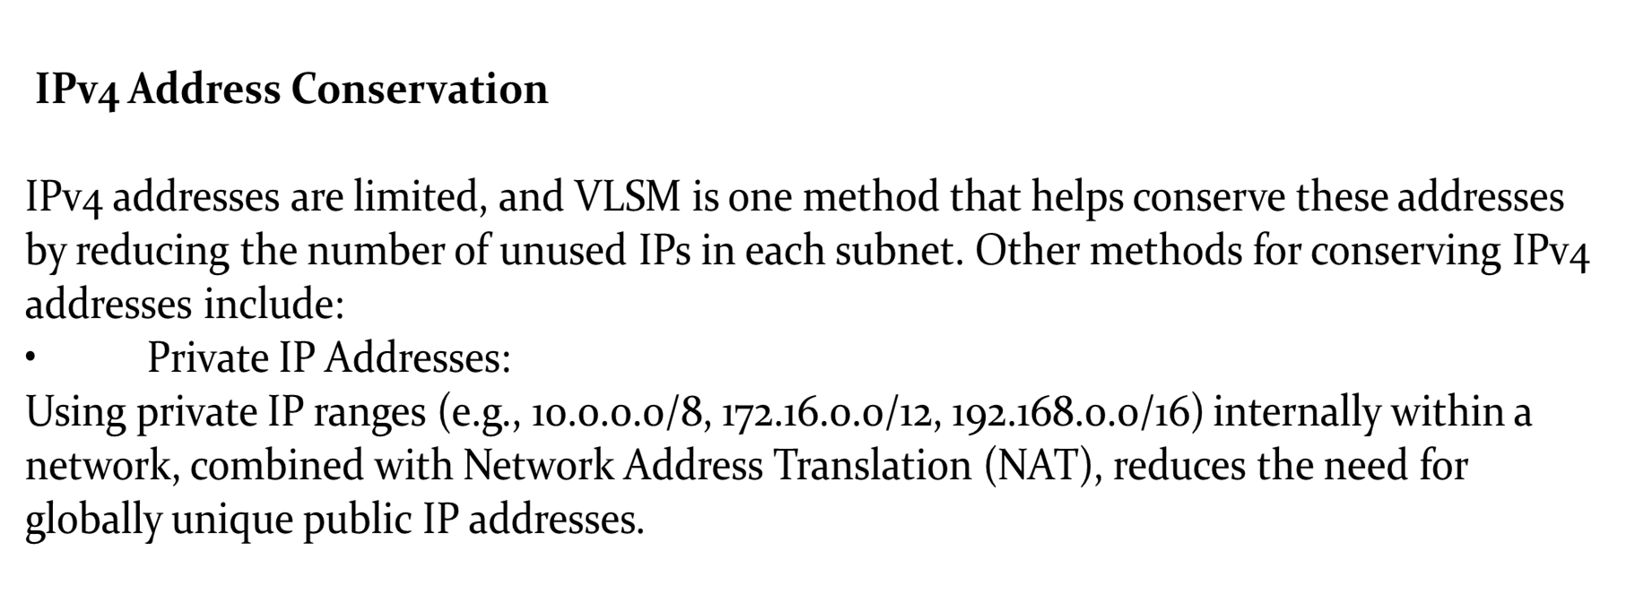

Slide 28
Classless Inter-Domain Routing (CIDR):
CIDR allows for more flexible allocation of IP address space compared to the older classful addressing system. It works in conjunction with VLSM to optimize the allocation of IP blocks
VLSM is an essential technique for conserving IPv4 address space by allowing networks to be divided into subnets of varying sizes. It helps make the most efficient use of limited IP addresses, especially in environments where address space is scarce.

Slide 29
CIDR (Classless Inter-Domain Routing)
What it is: A method of IP addressing that eliminates the traditional class-based system (Class A, B, C).
Key idea: Uses prefix notation (e.g., /16, /24) to represent subnet masks.
Why it's useful:
Allows more efficient use of IP address space.
Supports route aggregation (supernetting) to reduce routing table size.
Example:
192.168.0.0/22
This includes:
192.168.0.0
192.168.1.0
192.168.2.0
192.168.3.0

Slide 30
VLSM (Variable Length Subnet Masking)
What it is: A technique that allows subnets of different sizes to be created from a single IP block.
Key idea: You subnet a subnet, allocating IPs based on actual need.
Why it’s useful:Optimizes address usage.
Avoids waste in small networks.
Example: If you have 192.168.1.0/24, you can divide it into:
/25 (128 hosts)
/26 (64 hosts)
/27 (32 hosts)
/30 (2 hosts, for point-to-point)

Slide 31
Differences Between VLSM and CIDR
Feature | VLSM | CIDR
Full Name | Variable Length Subnet Masking | Classless Inter-Domain Routing
Used for | Subnetting within private/internal networks | Aggregating public IPs to reduce routing table size
Purpose | Efficiently allocate IP addresses by creating subnets of different sizes within a larger network | Combine multiple networks into one summarized route (route aggregation)
Context | Used inside organizations (LAN, private networks) | Used between ISPs and on the internet (WAN, routing tables)
How it works | Breaks a network into subnets of various sizes depending on host needs | Combines IP blocks to reduce the number of routing entries (e.g., summarizing 4 /24 blocks into one /22)
Example | 192.168.1.0/24 split into /25, /26, /27, etc. | Advertise 192.0.0.0/22 instead of 4 separate /24 networks

Slide 32
EXAMPLE
Suppose you have a large network block like 192.168.1.0/24 and need different subnets for different parts of your network. With VLSM, you can divide it as:
192.168.1.0/28 for a subnet with up to 14 hosts.
192.168.1.16/30 for a point-to-point link that requires only 2 usable IPs.
192.168.1.32/26 for a subnet with up to 62 hosts.
Each subnet uses just enough IP addresses to meet the requirements, minimizing waste.

Slide 33
In this example, you're demonstrating Variable Length Subnet Masking (VLSM), which allows a network administrator to divide a larger IP address block into subnets of different sizes based on the number of required hosts. This helps to minimize the waste of IP addresses by assigning different subnet sizes based on the specific needs of each segment.
1. 192.168.1.0/28 (For up to 14 hosts):
Subnet Mask: 255.255.255.240
Block size: 16 IP addresses (including network and broadcast addresses)
Usable IP addresses: 14 (after excluding the network and broadcast addresses)
Address Range: 192.168.1.1 - 192.168.1.14
Network Address: 192.168.1.0
Broadcast Address: 192.168.1.15
This subnet is ideal for a small group of devices, such as a small office or department that needs fewer than 16 IPs.

Slide 34
2. 192.168.1.16/30 (For a point-to-point link with 2 usable IPs)
Subnet Mask: 255.255.255.252
Block size: 4 IP addresses (including network and broadcast addresses)
Usable IP addresses: 2 (after excluding the network and broadcast addresses)
Address Range: 192.168.1.17 - 192.168.1.18
Network Address: 192.168.1.16
Broadcast Address: 192.168.1.19
This is perfect for point-to-point connections, such as a link between two routers, where only two IP addresses are needed.

Slide 35
3. 192.168.1.32/26 (For a subnet with up to 62 hosts)
Subnet Mask: 255.255.255.192
Block size: 64 IP addresses (including network and broadcast addresses)Usable IP addresses: 62 (after excluding the network and broadcast addresses)Address
Range: 192.168.1.33 - 192.168.1.94
Network Address: 192.168.1.32
Broadcast Address: 192.168.1.95
This larger subnet is suited for a department or network segment that requires up to 62 IP addresses, such as a medium-sized office or a group of servers.
In this example, VLSM efficiently divides the 192.168.1.0/24 block to accommodate different subnet sizes based on specific needs. By using VLSM, you avoid wasting IP addresses in situations where smaller subnets suffice, such as point-to-point links or smaller groups of hosts.
Each subnet is tailored to meet specific requirements, ensuring the network uses IP space efficiently.

Slide 36
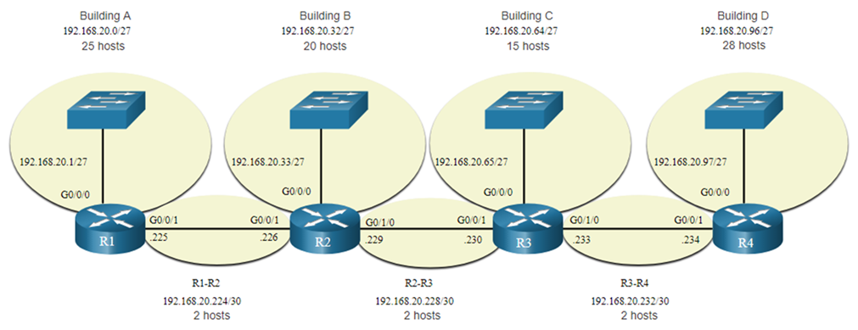
VLSM Topology Address Assignment 1
Using VLSM subnets, the LAN and inter-router networks can be addressed without unnecessary waste as shown in the logical topology diagram.

Slide 37
How many usable IP addresses are available in a /27 subnet?
Why is a /30 subnet used for the router-to-router links?
How many IP addresses are wasted in Building C with the current /27 subnet?
What is the subnet mask for the link between R2 and R3?
Design a more efficient subnetting scheme using VLSM to minimize IP address waste across the network. What subnet sizes would you assign to each segment?
If Building D grows to require 35 hosts, what subnet mask would you assign to accommodate this?
What would the new network range be?
What is the broadcast address for Building A's subnet? List all usable IP addresses in the R1-R2 link subnet.

Slide 39
INTRODUCTION TO IPv6 (Internet Protocol Version 6)

Slide 40
IPv6 (Internet Protocol Version 6)
IPv6 (Internet Protocol version 6) is the most recent version of the Internet Protocol (IP), designed to address the limitations of IPv4, particularly the shortage of available IP addresses. IPv6 uses a 128-bit addressing system, vastly increasing the number of possible addresses compared to the 32-bit addressing used by IPv4.
IPv6 was developed to overcome IPv4’s limitations, particularly the exhaustion of IPv4 addresses due to the rapid expansion of the internet. In addition to solving the address exhaustion problem, IPv6 brings improvements in routing efficiency, security, and ease of configuration, making it more suitable for the future of internet-connected devices.

Slide 41
Internet Protocol Version 6
Address Format: IPv6 was developed to address the limitations of IPv4, notably its address space.
IPv6 uses a 128-bit address format, allowing for approximately So, the total number of possible IPv6 addresses is approximately 340 undecillion addresses (340 trillion trillion trillion). addresses (2^128) =340,282,366,920,938,463,463,374,607,431,768,211,456), far more than IPv4.
An IPv6 address is written in hexadecimal format, separated by colons, and consists of 8 groups of 16 bits (4 hexadecimal digits per group).
Example Address: 2001:0db8:85a3:0000:0000:8a2e:0370:7334

Slide 42
Benefits of IPv6:
Larger Address Space: IPv6 provides a virtually limitless number of unique addresses, solving the exhaustion issue of IPv4.
Simplified Network Configuration: IPv6 supports auto configuration, eliminating the need for DHCP in many cases.
Improved Routing Efficiency: IPv6 was designed with hierarchical addressing, improving routing and reducing the size of routing tables.
Built-in Security: IPv6 mandates support for IPsec, providing improved security features compared to IPv4.
The transition to IPv6 has been gradual. To support coexistence, techniques like Dual-stack (running both IPv4 and IPv6) and
Tunneling (encapsulating IPv6 packets within IPv4) are used.
However, IPv4 remains in use across many networks today, though IPv6 adoption continues to increase as the demand for IP addresses grows.

Slide 43
IPv6 Address Types
Link-Local Address
An IPv6 address valid only within a specific network segment or link.
Used for communication between devices on the same local network segment. Essential for network operations such as neighbor discovery and automatic address configuration.
Automatic Configuration: Automatically assigned by IPv6-enabled devices when they connect to a network.
Prefix: fe80::/64
Format: Typically followed by an interface identifier that is unique to the device within the local network.
Example:
Address: fe80::1a2b:3c4d:5e6f:7g8h
Usage: Local communications and network operations within the same link.

Slide 44
Unique Local Address (ULA)
An IPv6 address unique within an organization or site but not routable on the public Internet. Used for internal communication within an organization or site, similar to private IPv4 addresses but unique across multiple organizations.
Prefix: fc00::/64
Equivalent to private IPv4 addresses, used within local networks but not routable on the public internet.
Identifies subnets within the organization.
Example:
Address: fc00::1234:5678:9abc:def0
Internal communication, isolated from global Internet traffic.

Slide 45
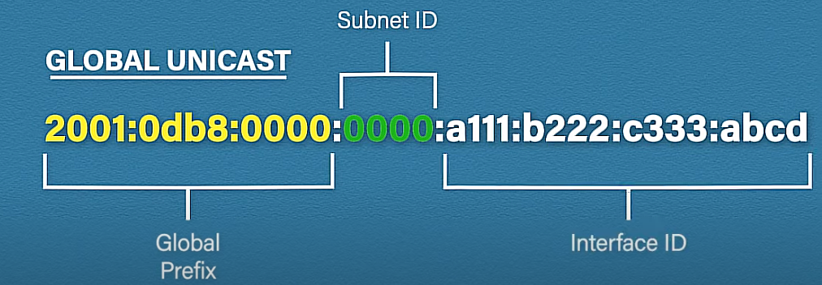
Global Address
Also known as a Global Unicast Address, this IPv6 address is globally unique and routable on the public Internet.
Used for communication between devices across the Internet, similar to a public IPv4 address, Prefix: 2000::/64
Global Routing Prefix: Identifies the global network or organization.
Subnet ID: Identifies subnets within the organization.
Interface Identifier: Uniquely identifies the device within the subnet.
Example:
Usage: Communication over the global Internet, accessible from anywhere.
Multicast Addresses : Used to deliver packets to multiple interfaces (e.g., multicast groups).Begin with ff00::/8

Slide 46
How to Write IPv6 Addresses
IPv6 uses 8 groups of 4 hexadecimal digits (each group = 16 bits), separated by colons:
Example: 2001:0db8:0000:0000:0000:ff00:0042:8329
Shortening Rules:
Leading zeros in each block can be removed:
2001:db8:0:0:0:ff00:42:8329
Consecutive blocks of zeros can be replaced with :: (but only once):
2001:db8::ff00:42:8329

Slide 47
Summary:
Link-Local Addresses (fe80::/64) are used for local communication within a network segment.
Unique Local Addresses (fc00::/64 - fd00::/64 ) are for internal organization use, providing unique identification within a site but not on the global Internet.
Global Addresses (2000::/64) are routable on the global Internet, used for public communication across the web.
Multicast Addresses: (ff00::/64) Used to deliver packets to multiple

Slide 48
IPv6 subnetting
IPv6 subnetting refers to dividing a larger IPv6 address block into smaller, more manageable segments (subnets), much like IPv4 subnetting.
However, IPv6 subnetting is designed to be simpler and more scalable, thanks to the enormous address space provided by IPv6.
IPv6 Address Structure:
An IPv6 address is 128 bits long, and it's generally divided into two main parts:
Network Prefix (the higher-order bits): Identifies the network or subnet.
Interface Identifier (Host portion): Identifies a specific interface within that network
Example IPv6 address: 2001:0db8:85a3:0000:0000:8a2e:0370:7334

Slide 49
This is usually divided as:
Network Prefix: 2001:0db8:85a3 (first 64 bits)
Interface Identifier: 0000:0000:8a2e:0370:7334 (last 64 bits)
IPv6 subnetting works by borrowing bits from the Interface Identifier portion of the address to create smaller networks.
The subnet mask is represented in CIDR notation, like /64, /56, etc.
For example, an ISP might give you a /48 prefix:
2001:db8:abcd::/48
This prefix can be further subnetted by modifying bits beyond the 48th bit, allowing for multiple subnets.

Slide 50
How to Count Prefix Length IPv6 addresses have 128 bits total, arranged in 8 blocks of 4 hex digits each.
1 hex digit = 4 bits 1 block (4 hex digits) = 16 bits
So when counting:
/16 = first 1 block is network
/32 = first 2 blocks are network
/48 = first 3 blocks are network
/64 = first 4 blocks are network
/128 = all blocks are network (no host space)

Slide 51
/48 Subnet:
A common allocation from ISPs to large organizations. This leaves 16 bits for subnetting, giving 65,536 subnets, each with a /64 prefix.
Example:
2001:db8:abcd:0000::/64
2001:db8:abcd:0001::/64
2001:db8:abcd:0002::/64
/64 Subnet:
Most common size for local area networks (LANs). It leaves 64 bits for host addresses, allowing for 2^64 (about 18 quintillion) unique addresses per subnet.
Example
2001:db8:abcd:1::/64
/56 Subnet:
Sometimes assigned to residential customers, leaving 8 bits for subnetting (256 subnets), each with a /64 prefix.
Example:
2001:db8:abcd:1200::/56
2001:db8:abcd:1210::/56
/128 Subnet:
Refers to a single IPv6 address, often used for loopback interfaces or point-to-point links.

Slide 52
In IPv6, determining the number of usable host addresses in a given subnet is straightforward
because of the large address space. Here’s how you calculate the number of available hosts
in an IPv6 subnet:
Formula to Calculate the Number of Hosts:
The number of usable host addresses in an IPv6 subnet is determined by subtracting
the network portion from the total 128-bit address space.
Number of Host Bits=128−Prefix Length
Once you have the number of host bits, the total number of available addresses is:
Number of Addresses=2Host Bits
Example Calculations:
/64 Subnet:
In a /64 subnet, the network portion takes up 64 bits, leaving 64 bits for hosts.
Number of host bits = 128−64=64
Number of addresses = 2^64=18,446,744,073,709,551,616

Slide 53
Subnet:
In a /48 subnet, the network portion takes up 48 bits, leaving 80 bits for hosts.
Number of host bits = 128−48=80.
Number of addresses = 2^80=1.20893×10^24 addresses.
/128 Subnet (Single Address):
A /128 subnet means there are no bits left for host addresses (i.e., it’s a single address).
Number of host bits = 128−128=0
Number of addresses = 2^0 =1 (i.e., a single address).
Usable vs. Total Addresses:
In IPv6, all addresses are generally usable within a subnet, unlike IPv4 where the first (network) and last (broadcast) addresses are reserved. However, depending on your configuration, you may reserve some addresses for specific purposes, such as the link-local address (fe80::/10) or special addresses like the unspecified address (::/128).

Slide 54
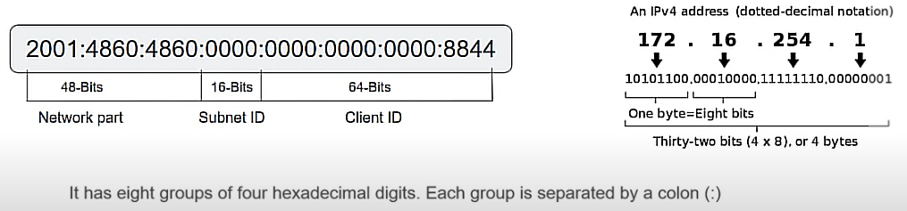
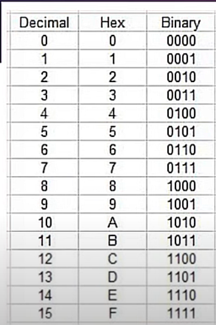
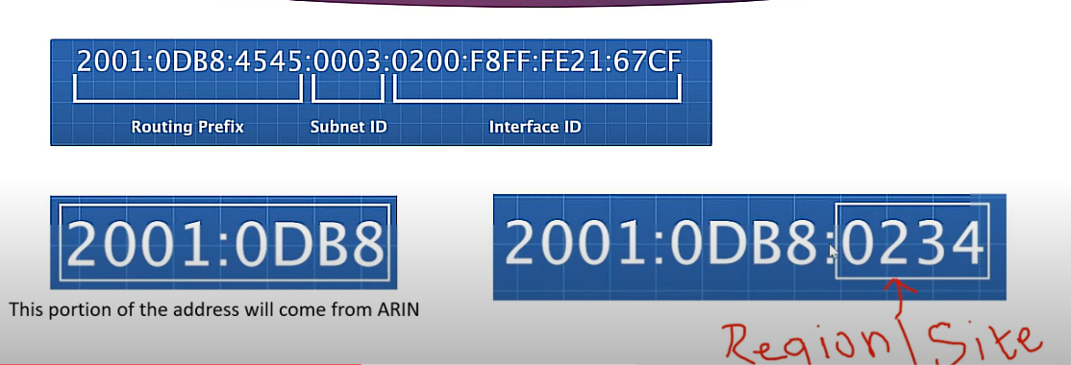
IPv6 Subnetting Strategy
Residential Users: Often allocated a /56 block, allowing for multiple /64 subnets for home networks.
Organizations/Enterprises: Typically receive /48 blocks, allowing them to create up to 65,536 subnets for larger networks.
/64 for Each Subnet: It's recommended to use /64 subnets for most LANs because this size is optimal for IPv6's stateless auto configuration (SLAAC).

Slide 55
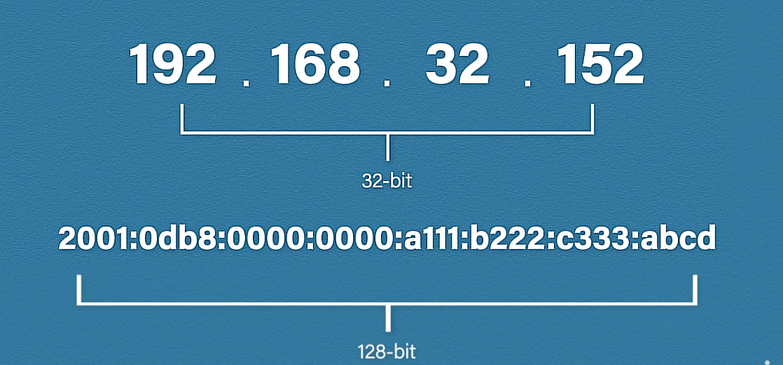
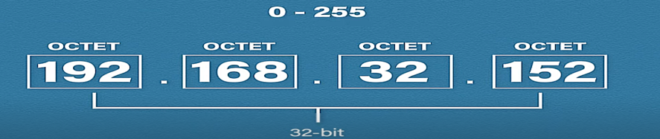
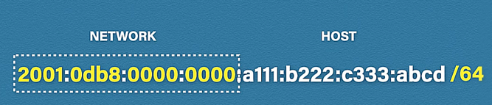
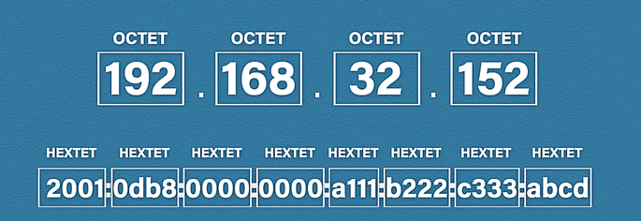
IPV6 ADDRESSING SCHEM

Slide 56
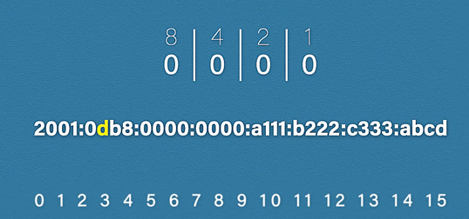
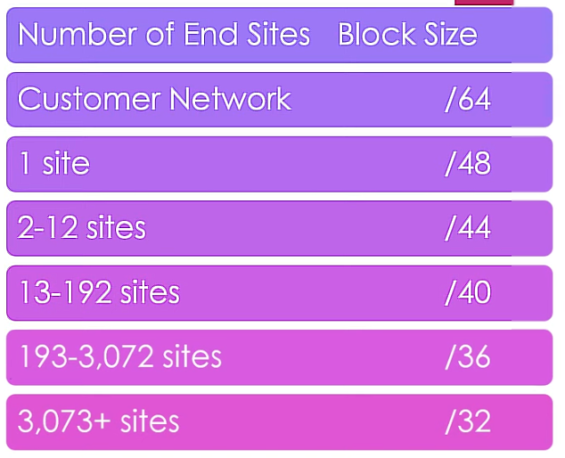
IPV6 ADDRESSING OCTET
formula From Hex/Decimal to Binary
IPV6 SUBNATE BLOCK

Slide 57
IPv6 CIDR (Classless Inter-Domain Routing)
In IPv6, CIDR (Classless Inter-Domain Routing) is used to define networks by their prefix length.
The prefix length tells us how many bits are used for the network portion of the address, with the remaining bits available for host addresses within that subnet
How IPv6 CIDR Works : An IPv6 address has 128 bits.
The prefix length indicates how many bits are fixed for the network portion.
The remaining bits after the prefix length are for the host portion, which defines how many unique addresses are available in that subnet.
For example:/128 means all 128 bits are used for the network, leaving no bits for host addresses, so it represents a single IP./64 is the most common subnet size, leaving 64 bits for hosts, which gives a massive number of addresses (2^64).

Slide 58
Steps to Subnet with CIDR
Step 1 — Start with your base network
Example IPv6:
ruby
CopyEdit
2001:db8:abcd::/48
This means first 48 bits are network bits.
Remaining bits = 128 − 48 = 80 bits for hosts.
Step 2 — Decide how many subnets you need
Example: We need 4 subnets.
Formula for extra bits needed:
2n≥Number of Subnets Needed2^n \geq \text{Number of Subnets Needed}2n≥Number of Subnets Needed
Here:
2^n ≥ 4 → n = 2
So we borrow 2 bits from the host portion.

Slide 59
Step 3 — Calculate the new prefix length
Original prefix = /48 Borrow 2 bits = /50 Now we have 4 subnets of /50.
Step 4 — Find the subnet increment
IPv6 increments depend on how many bits are borrowed.
/48 means subnet boundaries change every 65,536 addresses in the fourth block (because 16 bits per block).
Borrowing 2 bits changes that increment.
For /50:
Network bits = 50, so we have 14 bits left in the 4th block.
Increment = 2^(16−14) = 4 in that block.
Step 5 — List your subnets
Base: 2001:db8:abcd::/48
Subnets (/50):
2001:db8:abcd:0000::/50
2001:db8:abcd:0004::/50
2001:db8:abcd:0008::/50
2001:db8:abcd:000c::/50
Quick IPv6 CIDR Rules
Each hex digit = 4 bits
Each block (4 hex digits) = 16 bits
Increase prefix length (/n) to create more subnets
Decrease prefix length to have fewer, bigger networks

Slide 60
